Slide 1
The Ecosystem Concept
August 29, 2019

Slide 2
What is ecosystem ecology?

Slide 3
Ecology: definition
The study of the relationships between organisms and:
Each other
The environment

Slide 4
Ecology: definition
The study of the relationships between organisms and:
Abiotic environment
Biotic environment

Slide 5
What aspects of the abiotic and biotic environment influence organismal functioning?
Notes:
Take a few minutes to discuss

Slide 6
Hierarchy of Ecology
Physio-logical Ecology

Slide 7
Hierarchy of Ecology
Physio-logical Ecology
Population Ecology

Slide 8
Hierarchy of Ecology
Physio-logical Ecology
Population Ecology
Community Ecology

Slide 9
Hierarchy of Ecology
Physio-logical Ecology
Population Ecology
Community Ecology
Ecosystem Ecology

Slide 10
Ecosystem ecology is the study of the interactions between organisms and their environment as an integrated system

Slide 11
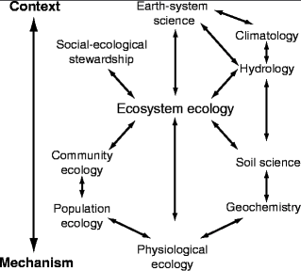

Slide 12
What is an ecosystem?

Slide 13
How big is an ecosystem?

Slide 14
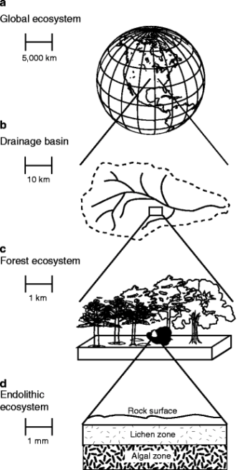
Ecosystems can vary in size!

Slide 15
Ecosystems can vary in size!
(but must include multiple organisms interacting with their abiotic and biotic environments)

Slide 16
Ecosystem Processes: “things an ecosystem does”

Slide 17
Controls Over Ecosystem Processes
Hans Jenny (US soil scientist) in 1941 first to formalize a quantitative model of soil formation as well as the “state factors” that set the bounds for characteristics of an ecosystem:
S = f (cl, o, r, p, t)

Slide 19
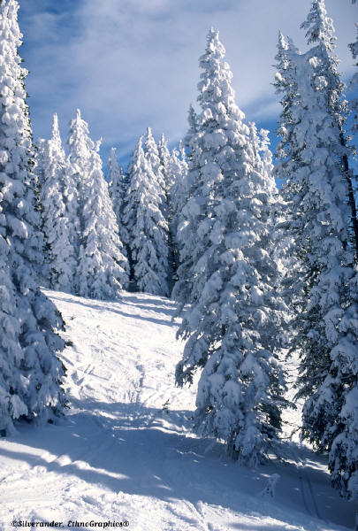
Cl
Climate
O
* Precipitation
* Temperature
R
P
T

Slide 20
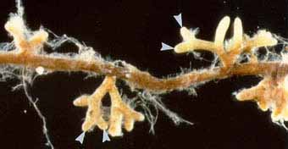
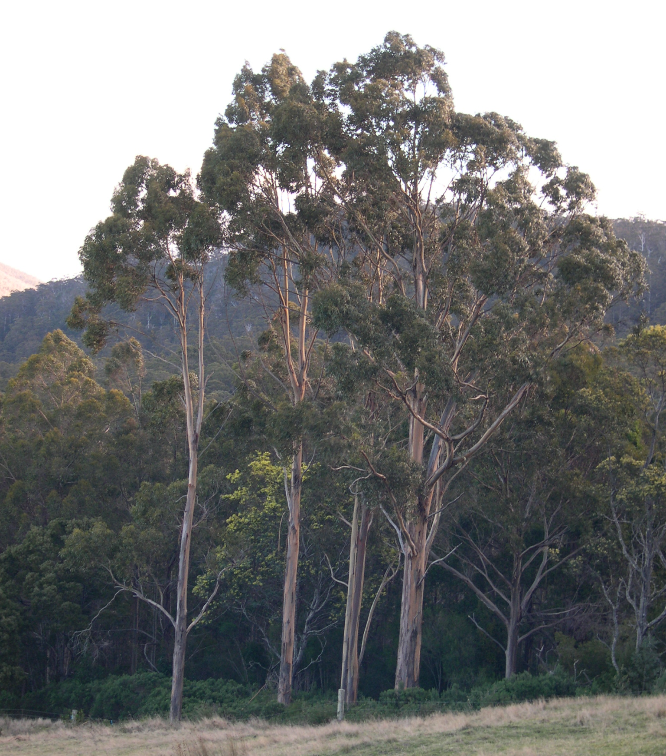
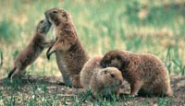
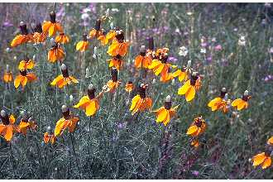
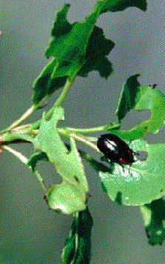
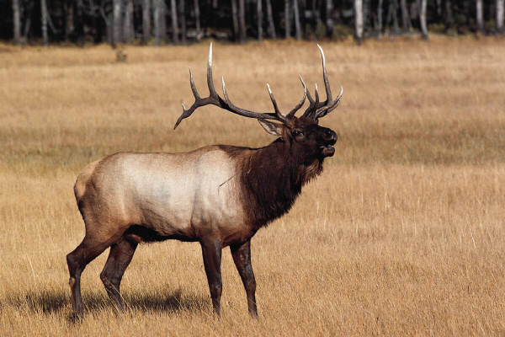
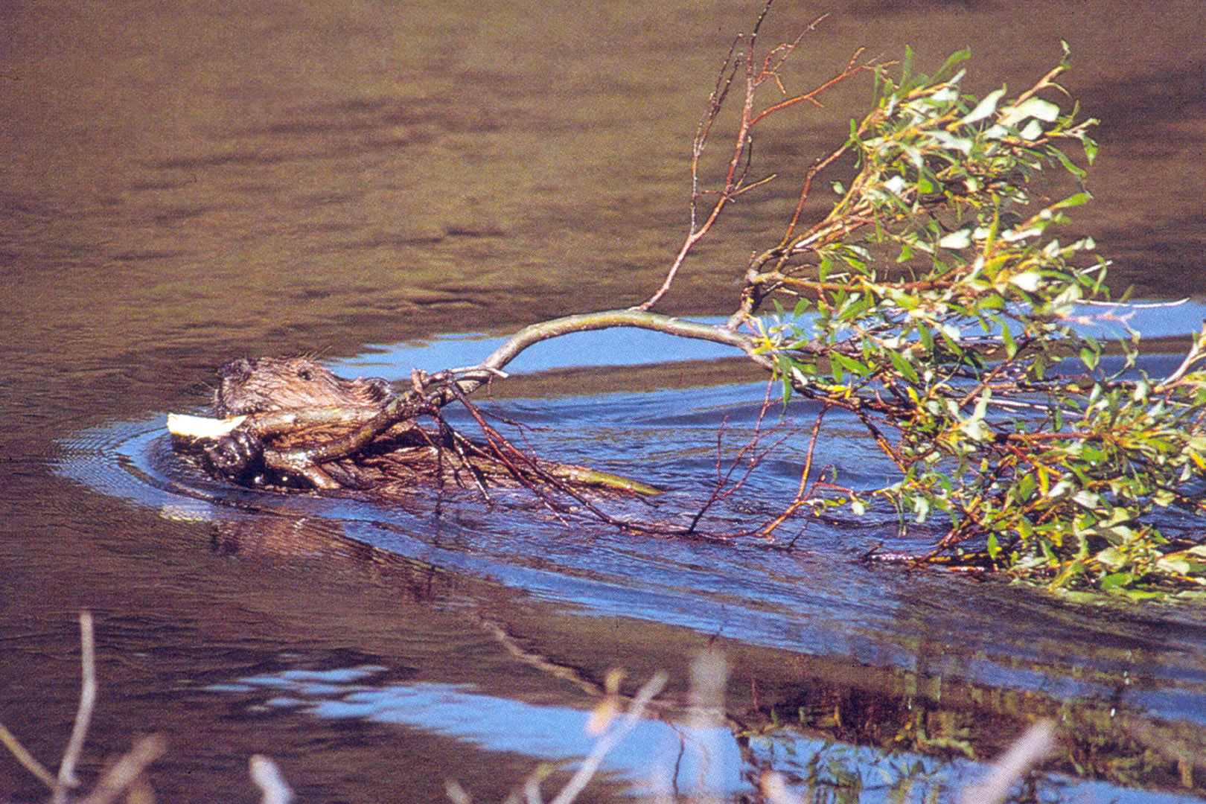
Cl
O
Organisms
R
P
T

Slide 21
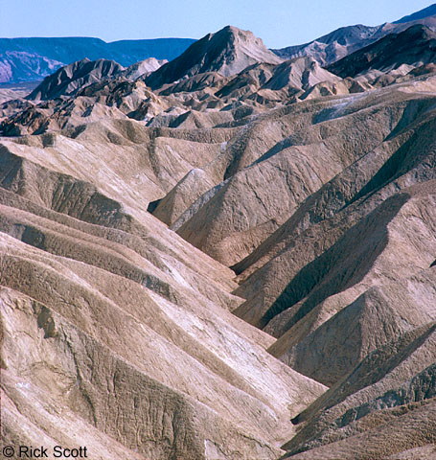
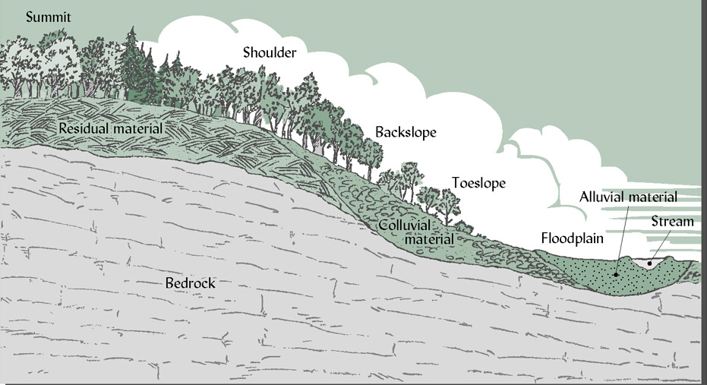
Cl
O
R
Relief/Topography
P
T

Slide 22
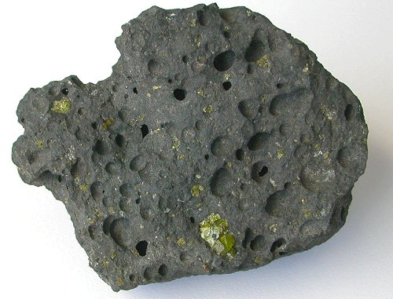
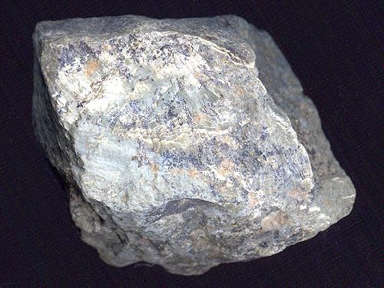
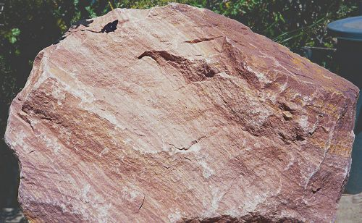
Cl
O
R
Igneous (basalt)
Metamorphic (schist)
P
Parent Material
T
Sedimentary (sandstone)

Slide 23
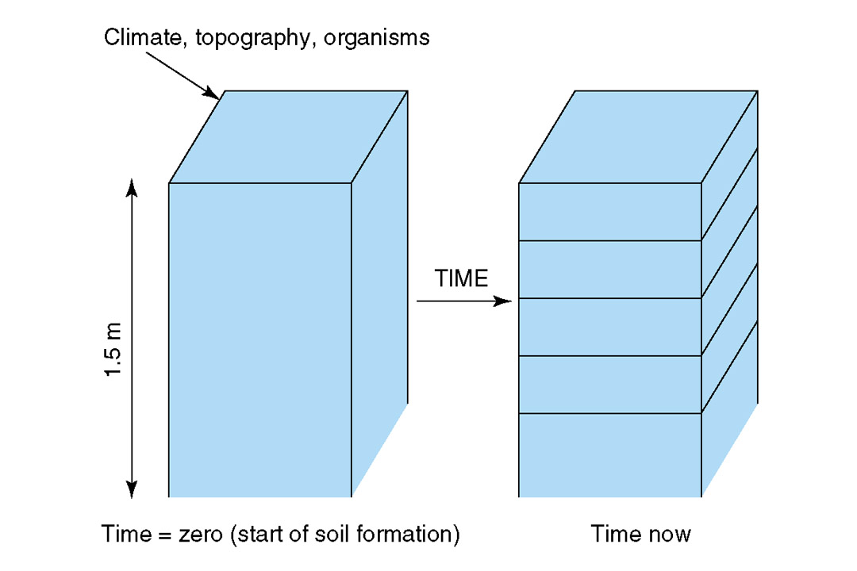
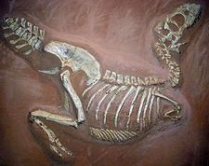
Cl
Development of Soil
O
R
Evolution
P
T
Time

Slide 24
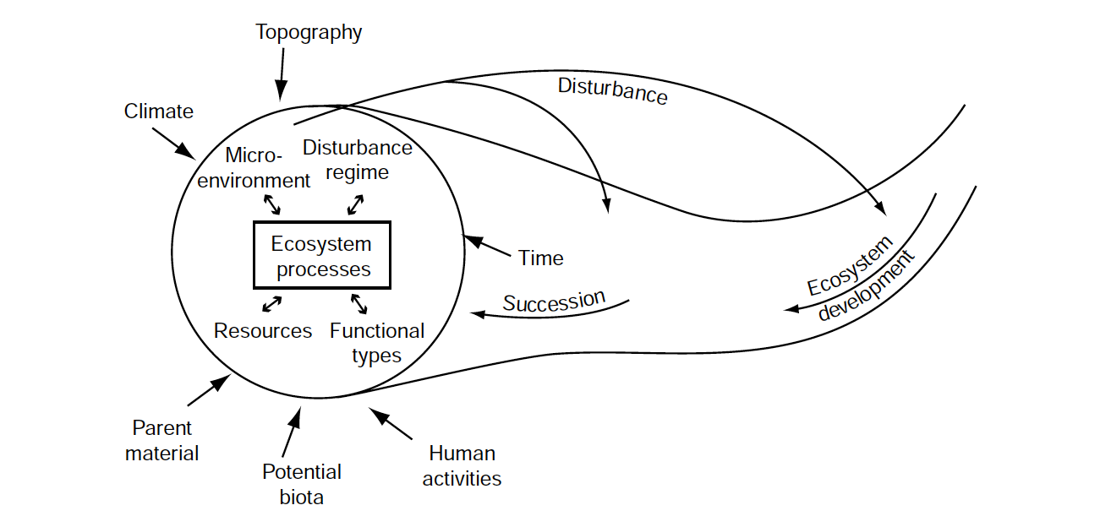
In your book, but modified from Chapin et al. (2006)

Slide 25
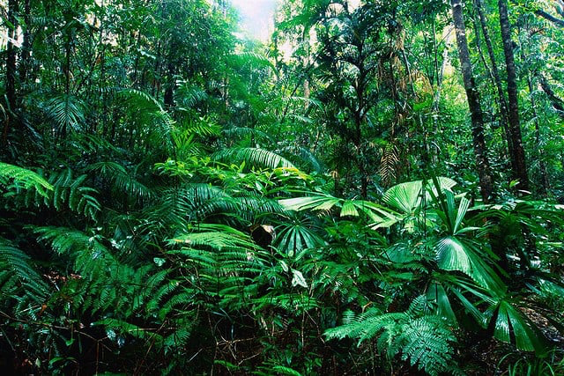
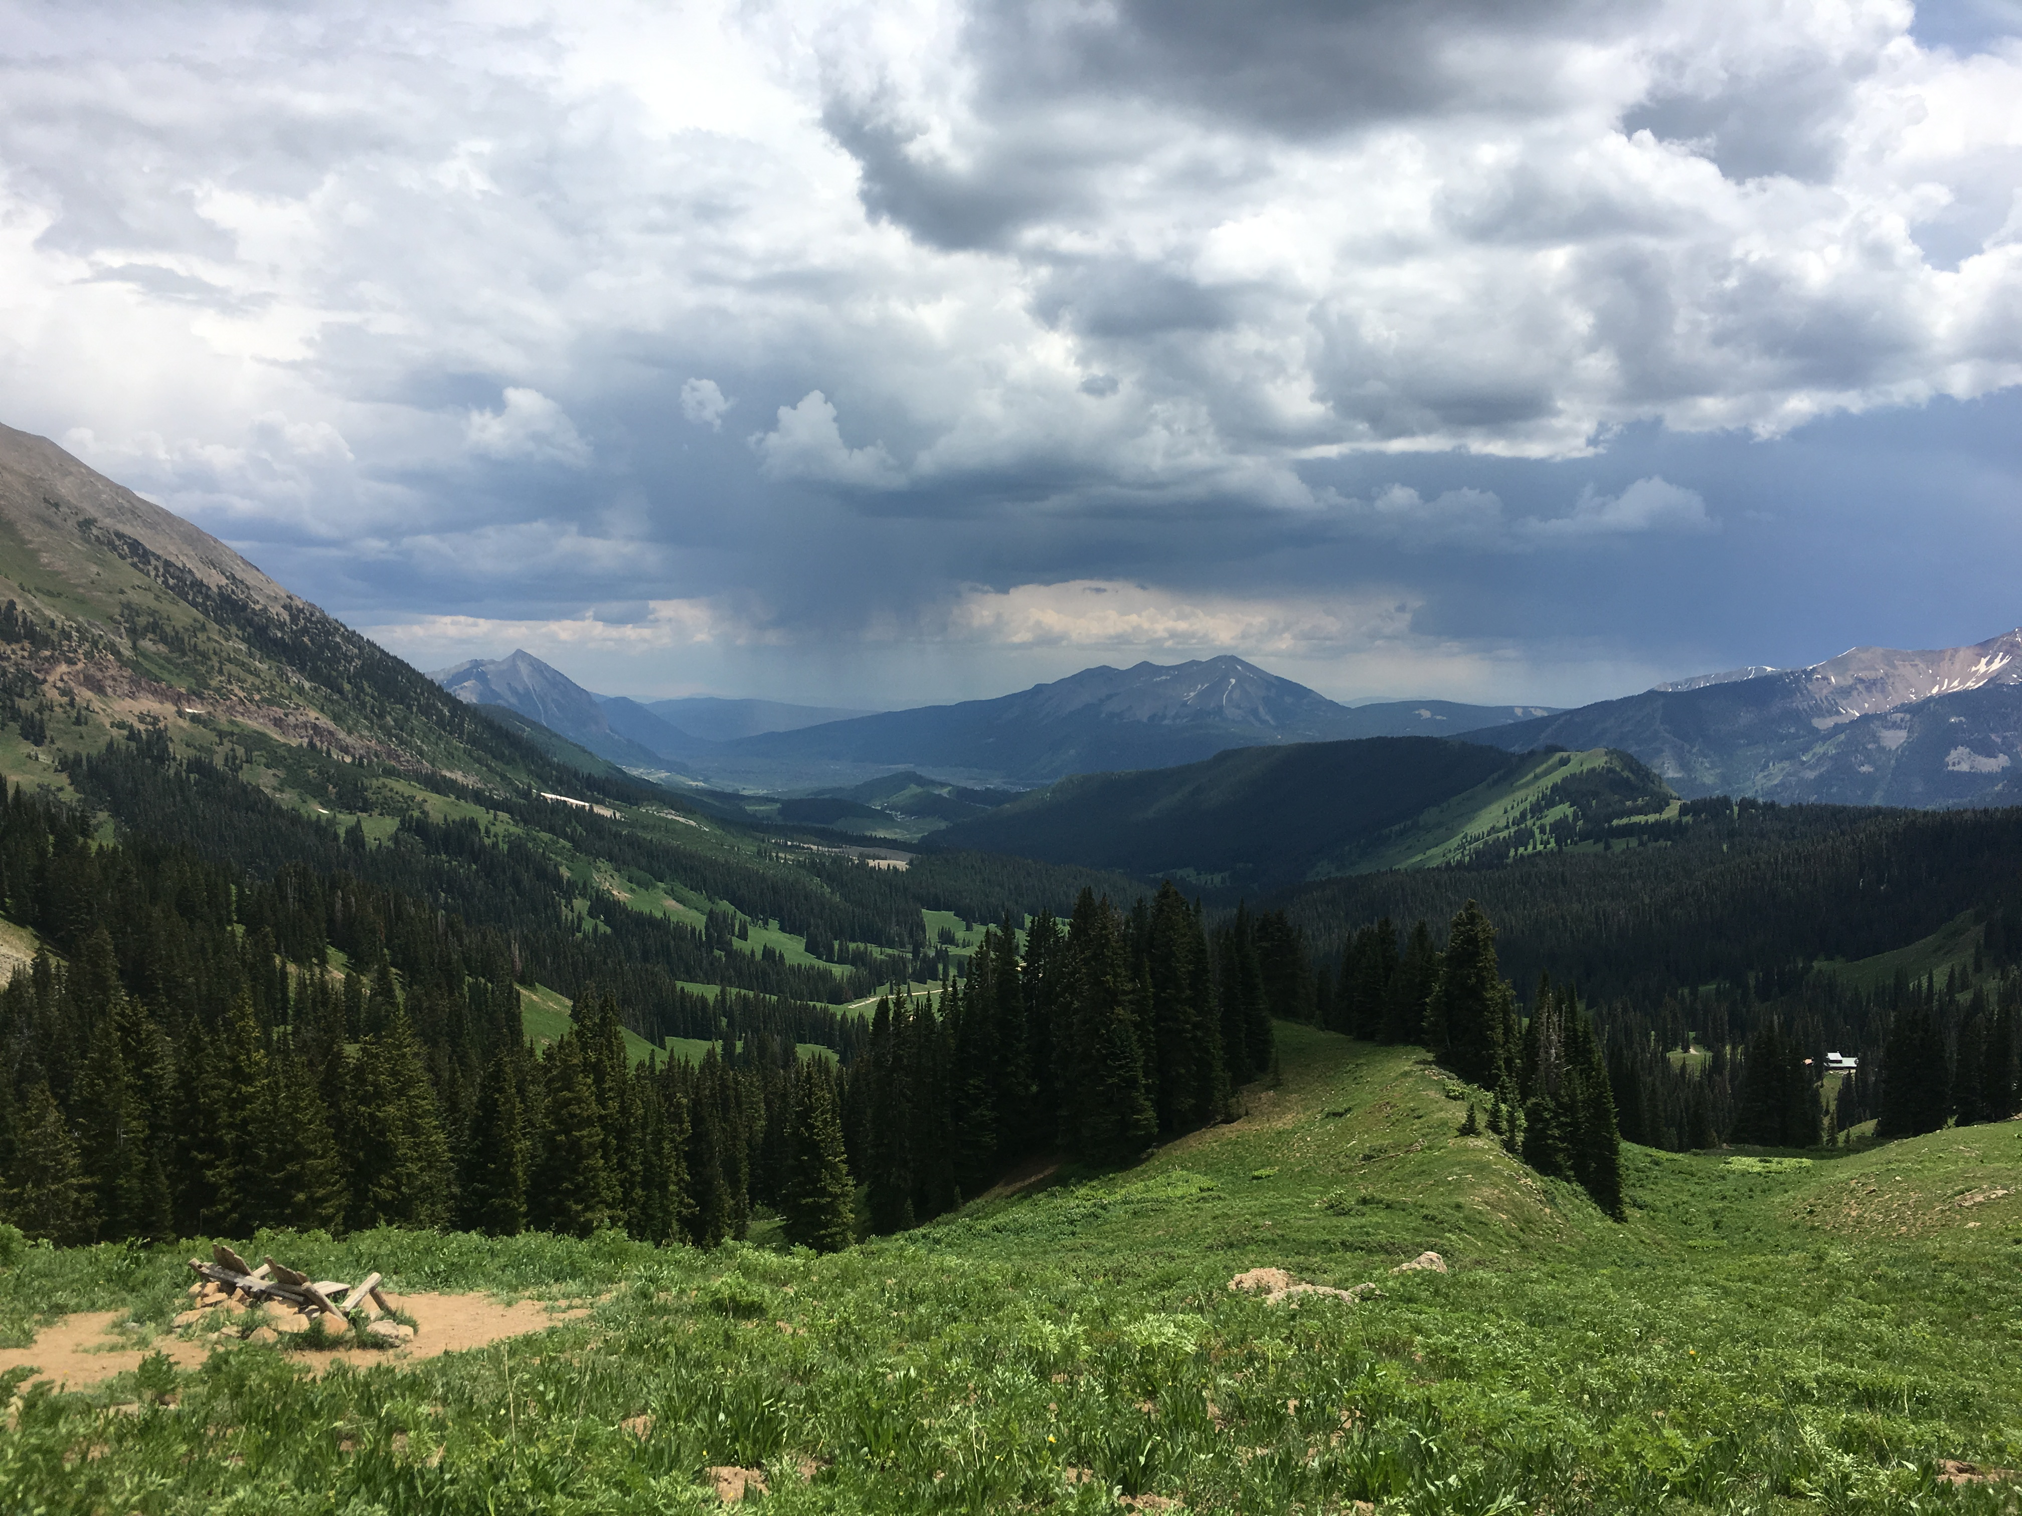
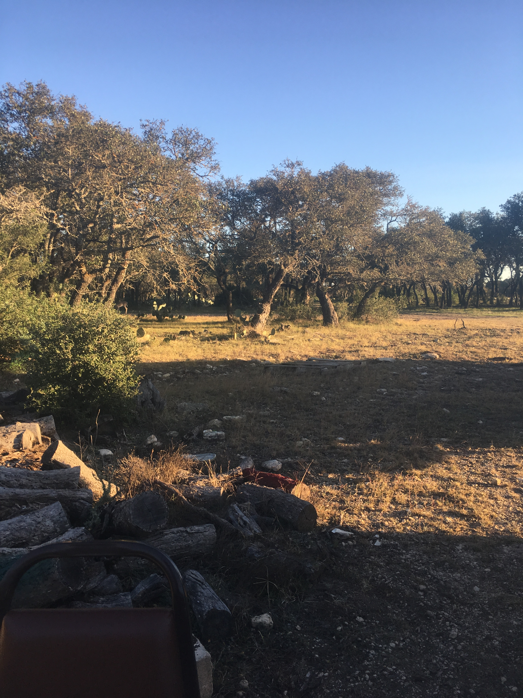

Slide 26
Climate
Wet --------- Dry

Slide 27
Organisms
Diverse --------- Depauperate

Slide 28
Topography
Steep --------- Flat

Slide 29
Parent Material
Igneous Sedimentary Basalt

Slide 30
Time
Old -------------- Recent

Slide 31
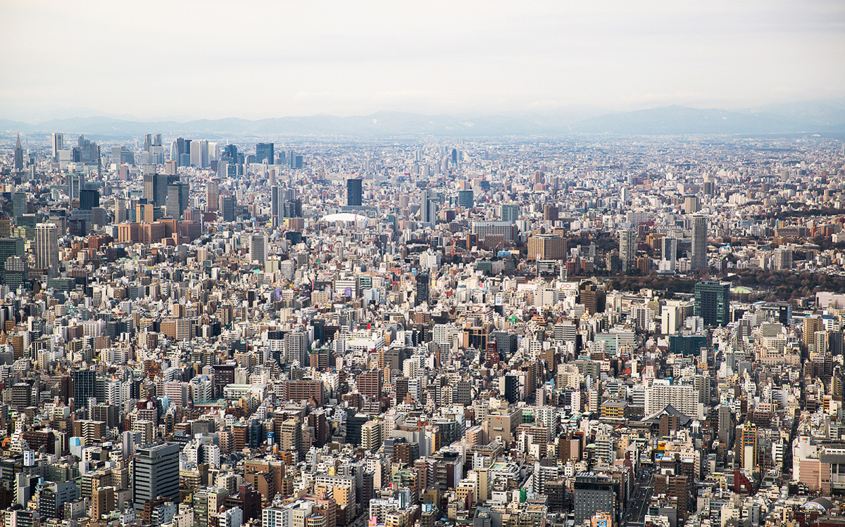
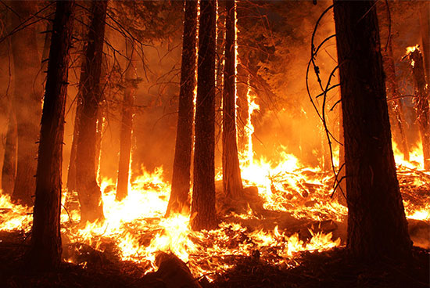
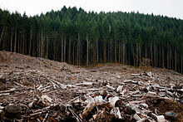
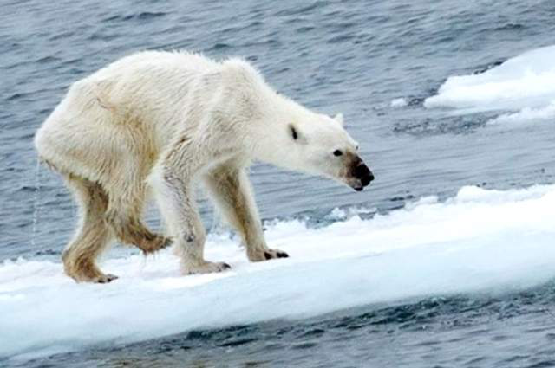

Slide 32
In your book, but modified from Chapin et al. (2006)

Slide 33
Ecosystem Services: “things an ecosystem provides”

Slide 34
What do humans get from ecosystems?

